Slide 1
Lecture 6:
Project Planning and Estimation (2)

Slide 2
Write it Down!
Project Scope
Estimates
Risks
Schedule
Control strategy
Software
Project
Plan

Slide 3
Function Point (FP) Estimation
Another method of estimating project to avoid drawbacks of LOC
Consists of three steps
  Calculate “count-total” from 5 measurement parameters
  Calculate “total of value adjustment factors” from 14 complexity factors
  Calculate the final Function Point (FP) by combining results from step 1 and 2
Notes:
[Animated sequence start]

Slide 4
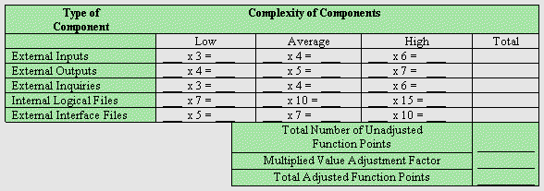
FP Estimation Step 1
Number of external Inputs (EIs): the number of user inputs or application transmission that provide distinct application oriented data or control information to the software. It is often used to update ILFs and distinguished from user inquires. User Entered Data
Number of external Outputs (EOs): e.g. reports, screens, error messages, etc.
Number of external Inquiries (EQs): e.g. a DB query requesting client info or price
Number of Internal Logical Files (ILFs): Discuss PFEE and hybrid-ss-min
Number of External Interface Files (EIFs): the number of all files that reside external to the application but provide data that may be of use to the application.
Notes:
[Animated sequence start]
EIFs can files outputted that are read into another system
Or
Files that are read into our system.

Slide 5
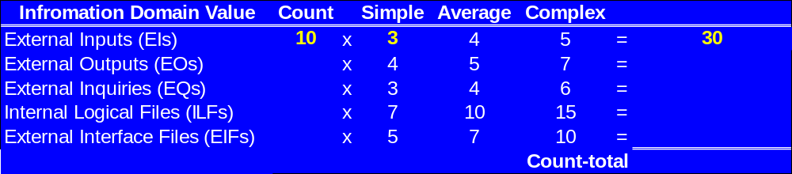
FP Estimation Step 1 (example)
6
Weighting factor
(e.g. 3 here)
Count x Weighting factor
(e.g. 10 x 3 = 30 )
Expected value
(e.g. 10 external inputs here)
Notes:
[Animated sequence continues]
The number of user inputs has been determined, and assessed as simple resulting in a count of 30.
Clearly, one could group inputs into simple, average and complex and calculate a count in that way.

Slide 6
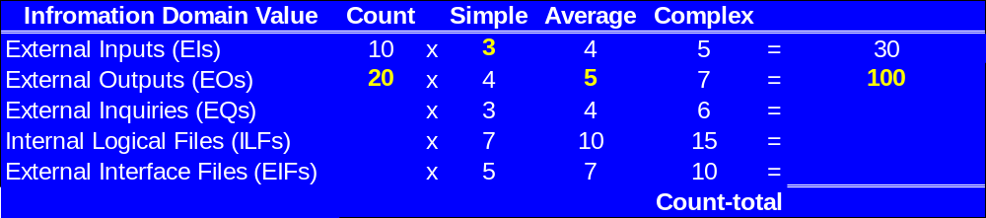
FP Estimation Step 1 (example)
6
Notes:
[Animated sequence continues]
Average complexity of user outputs selected.

Slide 7
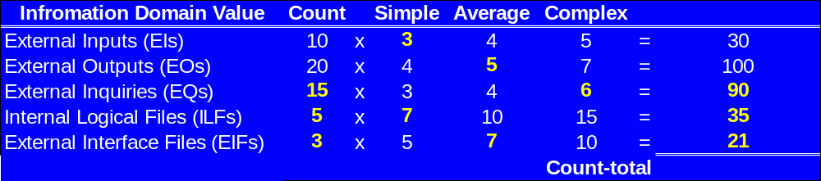
FP Estimation Step 1 (example)
6
Notes:
[Animated sequence continues]
Completion of entries.

Slide 8
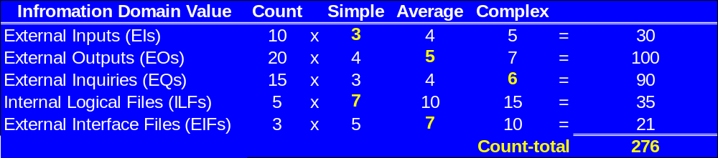
FP Estimation Step 1 (example)
6
Then we must consider 14 “value adjustment factors”
rated on a scale of 0 – 5 (Step 2 of FP Estimation):
No influence 0
Incidental 1
Moderate 2
Average 3
Significant 4
Essential 5
Notes:
[Animated sequence ends]
Total calculated.

Slide 9
14 Questions for Value Adjustment Factors
1. Does the system require reliable backup and recovery?
2. Are data communications required to transfer info to or from the application?
3. Are there distributed processing functions?
4. Is performance critical?
5. Will the system run on existing heavily utilized operational environment?
6. Does the system require on-line data entry?
7. Does the on-line data entry require input over multiple screens or operations?
8. Are the ILFs (internal logical files) updated on-line?
9. Are the inputs, outputs, files, or enquiries complex?
10. Is the internal processing complex?
11. Is the code designed to be reusable?
12. Are conversion and installation included in the design?
13. Is the system designed for multiple installations in different organizations?
14. Is the application designed to facilitate change and ease of use by the user?

Slide 10
FP Estimation Step 2 (example)
Factor | Rating
1. Reliable backup and recovery
2. Data communications
3. Distributed processing functions
4. Performance critical?
5. Will the system run on existing heavily utilised operational environment?
6. On-line data entry?
7. On-line data entry over multiple screens or operations
8. Are the master files updated on-line?
9. Are the inputs, outputs files or enquiries complex?
10. Is the internal processing complex?
11. Is the code designed to be reusable?
12. Are conversion and installation included in the design?
13. Is the system designed for multiple installations in different organisations?
14. Is the application designed to facilitate change and ease of use by the user?
5
0
2
4
1
4
3
5
3
2
1
1
5
3
Total of value adjustment factors = 39

Slide 11
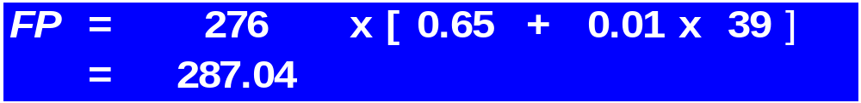
FP Estimation Step 3: FP Calculation
FP is then calculated as follows:
where the count-total comes from step 1,
Σ F_{i} (i = 1 to 14) is the total of value adjust factors from step 2,
the constants 0.65 and 0.01 are determined empirically.
With the example values:
Another example can be found on page 442-443 of the textbook (Chapter 15)
Notes:
Using the complexity adjustment factor
Note that the factor can increase of decrease the count.

Slide 12
Discussions of FP Approach
FP is based on characteristics of the software’s information domain and complexity.
FP is programming language independent.
FP is based on data more likely to be known earlier in the project.
Determining the complexity is relatively subjective. Some methods have been proposed to tackle this problem (one of them is covered in the tutorial)
FP has no direct physical meaning – it is just a number.
Notes:
Some things are easier for some than others.

Slide 13
Decomposition for Estimation
Break the problem up into the bits that must be solved individually.
- e.g. user interface, the file system, the database, the application.
Break each piece up further until we reach a size that is small enough to
which estimating methods can be applied.
Estimate the lines of code (LOC) or Function Points (FP) required for
each component.
The expected estimation value from the most likely, the most optimistic and the most pessimistic estimate values, can be computed as a weighted average of these estimates:
expected =
(optimistic + 4 x most likely + pessimistic)
6
We can then combine the estimates into a total.
Then we can use historical data to determine the effort required (in
person months) and the cost.

Slide 14
Decomposition for Estimation
An example of using the formula
expected =
(optimistic + 4 x most likely + pessimistic)
6
Suppose we estimate the line of code (LOC) for a user interface as follow:
most optimistic LOC = 1900
most pessimistic LOC = 2500
most likely LOC = 2300
then
(1900 + 4 x 2300 + 2500)
≈ 2267
Expected LOC =
6
We say the estimated LOC for the user interface is 2267

Slide 15
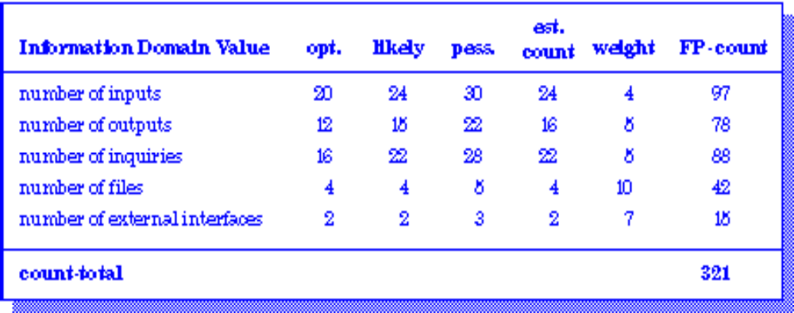
Example: FP Approach
Rounded values
4
expected =
(optimistic + 4 x most likely + pessimistic)
6

Slide 16
Normalized performance data
Given lines of code (LOC) or function points (FP) we can record
our efforts in terms of
errors per thousand LOC (KLOCs) or function point (FP)
defects per KLOC or FP
$ per KLOC or FP
pages of documentation per KLOC or FP
FP or KLOC per person-month
This allows us to use data from one project in another project.

Slide 17
Reconciling LOC and FP
Representative values developed by QSM (www.qsm.com, copyright 2002)
More details for other languages are on page 625 of the textbook (Chapter 22)

Slide 18
Summary
Another estimation method: FP
Step 1: Calculate “count-total” from 5 measurement parameters
Step 2: Calculate “total of value adjustment factors” from 14 complexity
factors
Step 3:
Expected estimation:
expected =
(optimistic + 4 x most likely + pessimistic)
6
Reconciling LOC and FP

Slide 19
Summary
Questions?
Notes:
Many criteria to consider:
Time
Group members and their commitment
Money and resources
Requirements known?
Expectation of versions
Software lifespan

Slide 20
Readings
Pressman (6th edition):
  Section 15.3 Metrics for the Analysis Model (Chapter 15)
  Chapter 22: Process and Project Metrics
    especially Section 22.2 Software Measurement
  Chapter 23: Estimation for Software Projects

